Slide 1

Speak Fluently & Confidently A2- Course 1

Slide 2
Session 3 – Revision 1
Let’s Review then Learn something New
Revision (1)
Talking about ‘Preferences’ & ‘Family’
https://befluent.me/

Slide 3
Session 3 – Revision 1
Part 1: Grammar
Part 2: What would you say in the following
situations? ( Idioms & collocations)
Part 2: Speaking Practice
https://befluent.me/

Slide 4
Session 1- Likes & Dislikes
Part 1: Grammar
https://befluent.me/

Slide 5
The Present Simple Tense (also called the Simple Present Tense)
1- Simple present tense with verb to 'be':
The verb ‘be’ is different from the other verbs in this tense. Let's look at ‘be’ first:
Here’s the positive form (positive means a normal sentence, not a negative or a question. This is sometimes called ‘affirmative’):
Positive | Positive Short Form
I am | I'm
you are | you're
he is | he's
she is | she's
it is | it's
we are | we're
they are | they're
For example:
I’m Scottish.
She’s hungry.
They’re always late.
Next, here's the negative. It's very easy. You only add ‘not’ after the verb ‘be’:
Negative | Negative short form
I am not | I'm not
you are not | you aren’t
he is not | he isn't
she is not | she isn’t
it is not | it isn't
we are not | we aren't
they are not | they aren't
For example:
I’m not cold.
He isn’t from Spain.
We aren’t at home.

Slide 6
Here's the 'yes / no' question form:
Yes / No Questions
am I ?
are you ?
is he ?
is she ?
is it ?
are we ?
are they ?
For example:
Am I next in the queue?
Are you from Tokyo?
Is he at the library at the moment?
If you'd like to make a ‘wh’ question, you just put the question word at the front
Wh Questions
Where am I ?
What are you ?
Why is he ?
Who is she ?
When are we ?
How are they ?
For example:
Where are you from?
Who is that girl?
Why are they still at work?

Slide 7
Write the correct form of verb to be in the present simple tense:
(she / be / kind?)
(they / be / German?)
(you / be / late?)
(I / be / early?)
(you / be / from London?)
(they / be / sad)

Slide 8
Present simple tense with other verbs:
With all other verbs, we make the present simple in the same way.
The positive is really easy. It's just the verb, with an extra ‘s’ if the subject is ‘he’, ‘she’, or ‘it’. Let's take the verb ‘play’ as an example:
Positive (of 'play')
I play
you play
he plays
she plays
it plays
we play
they play
For example:
I play tennis every week.
He likes chocolate.
They usually go to the cinema on Fridays.
Don't forget the ‘s’! Even really advanced students do this!
For a few verbs, there is a spelling change with ‘he’, ‘she’ and ‘it’ before the ‘s’.
For example, ‘study’ becomes ‘studies’. (will explain this in the next slide).
.
There are also few verbs which are irregular in the present simple:
'have' becomes 'has'
'do' becomes 'does'
'go' becomes 'goes'

Slide 9
Present Simple Spelling Changes
Some verbs have present simple spelling changes with 'he', 'she' or 'it’:’
Verbs that end in 'y’:
Verbs that end in 'y' often change 'y' to 'ie' before 's':
study becomes studies
try becomes tries
marry becomes marries
fly becomes flies
cry becomes cries
(Be careful! 'y' doesn't change to 'ie' if the ending is 'ay', 'ey', 'oy', 'uy'. So, play becomes plays, say becomes says, buy becomes buys, enjoy becomes enjoys, stay becomes stays)
Verbs that end in 's', 'sh', 'ch', or 'x’:
Verbs that end in 's', 'sh', 'ch' or 'x' often add 'e' before 's':
pass becomes passes
wash becomes washes
teach becomes teaches

Slide 10
Make positive present simple sentences:
(Adam / go to school every day)
(I / like swimming)
(you / play badminton on Saturdays)
(the class / begin at 9 a.m.)
they / sometimes go to the cinema)
. (Maria / love chocolate)
(we / study French)
(the Simpson’s / live in London)
Put the verb into the present simple. Be sure you spell it correctly!
She __________________ (play) tennis every Sunday.
2. He __________________ (buy) a cup of coffee every morning.
3. Julie __________________ (study) French at school.
4. Luke __________________ (try) hard to be polite.
5. She __________________ (enjoy) going swimming.
6. Lucy __________________ (wash) her hair every day.
7. John never __________________ (cry).
8. My mother always __________________ (say) that love is more important than money.

Slide 11
To make the negative form, you need to use ‘do not’ (don't) or ‘ does not’ (doesn't):
Negative (of 'play') | Negative Short Form
I do not play | I don't play
you do not play | you don't play
he does not play | he doesn't play
she does not play | she doesn't play
it does not play | it doesn't play
we do not play | we don't play
they do not play | they don't play
For example:
You don’t study very much.
Julie doesn’t like sport.
We don’t live in London.

Slide 12
Make negative present simple sentences:
(I / not / live in Paris) __________________________________________________________________
(she / not / come from Spain) __________________________________________________________________
. (John / not / work in a bank)
(they / not / get up at eight o’clock) __________________________________________________________________
(we / not / go to the cinema every Friday)
(you / not / read the newspaper every day) _________________________________________

Slide 13
How about the question form of the present simple tense?
(1) We use 'do' or 'does' before the subject to make the 'yes / no' question:
Yes / No questions
do I play ?
do you play ?
does he play ?
does she play ?
does it play ?
do we play ?
do they play ?
(2) Just like with 'be', if you'd like to make a 'wh' question, you just put the question word at the front:
Wh Questions
where do I play ?
what do you play ?
why does he play ?
who does she play ?
when do we play ?
how do they play ?

Slide 14
Make the present simple question:
(he / drive to work every day?)
(we / have enough time?) ________________________________________________
( what / you / eat in the morning?)
(they / write e-mails every day?) ____________________________________________________
when/ he / / read the newspaper?)
where / I / come on Mondays?)
(what / you / do at the weekend?)

Slide 15
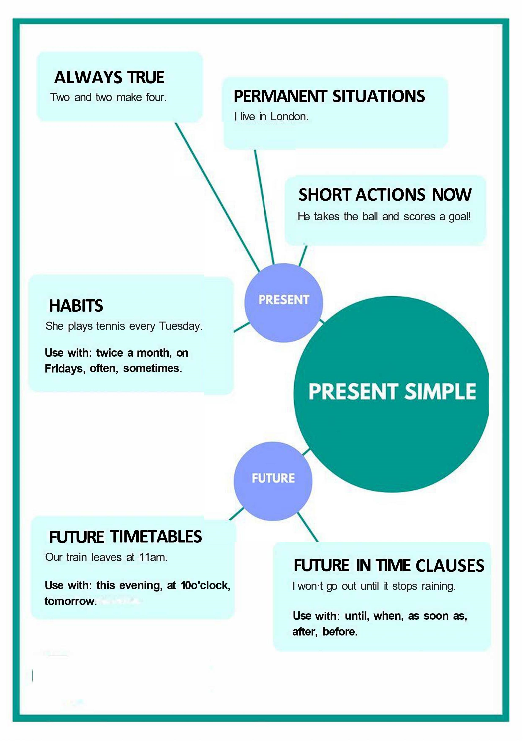
Session 1- Likes & Dislikes
https://befluent.me/

Slide 16
Session 1- Likes & Dislikes
When to use the Present simple tense- Function:
1: We use the present simple when something is generally or always true.
People need food.
It snows in winter here.
Two and two make four.
2: Similarly, we need to use this tense for a situation that we think is more or less permanent.
Where do you live?
She works in a bank.
I don't like mushrooms.
3: The next use is for habits or things that we do regularly. We often use adverbs of frequency (such as 'often', 'always' and 'sometimes') in this case, as well as expressions like 'every Sunday' or 'twice a month’.
Do you smoke?
I play tennis every Tuesday.
I don't travel very often.
https://befluent.me/

Slide 17
Session 1- Likes & Dislikes
When to use the Present simple tense- Function:
4: We can also use the present simple for short actions that are happening now. The actions are so short that they are finished almost as soon as you've said the sentence. This is often used with sports commentary.He takes the ball, he runs down the wing, and he scores!
Future Uses
5: We use the present simple to talk about the future when we are discussing a timetable or a fixed plan. Usually, the timetable is fixed by an organization, not by us.
School begins at nine tomorrow.
What time does the film start?
The plane doesn't arrive at seven. It arrives at seven thirty.
https://befluent.me/

Slide 18
Session 1- Likes & Dislikes
When to use the Present simple tense- Function:
6: We also use the present simple to talk about the future after words like ' 'when', 'until', 'after', 'before' and 'as soon as'. These are sometimes called subordinate clauses of time.
I will call you when I have time. (Not 'will have'.)
I won't go out until it stops raining.
I'm going to make dinner after I watch the news.
Conditional Uses 7: We use the present simple in the first and the zero conditionals.
If it rains, we won't come.
If you heat water to 100 degrees, it boils.
https://befluent.me/

Slide 19
Make the present simple, positive, negative or question:
I _________________ (be) in a café now.
2. _________________ (she / play) tennis every week?
3. They _________________ (go) to the cinema every Wednesday.
4. _________________ (she / be) a singer?
5. You _________________ (find) the weather here cold.
6. _________________ (they / be) on the bus?
7. Lucy _________________ (ride) her bicycle to work.
8. Why _________________ (he / be) in France?
9. I _________________ (not / play) the piano often.
10. It _________________ (not / be) cold today.
Where _________________ (Harry / study?

Slide 20
Session 3 – Revision 1
Part 2-: What would you say in the following
situations? ( Idioms & collocations)
https://befluent.me/

Slide 21
Remember:

Slide 22
Lesson 1: Likes, Dislikes, & Preferences
Vocabulary Quiz
especially • with you • either • mind • takes forever
I don’t spending some time outside .
I agree. I’m on that point.
I like swimming, but it to get to the pool.
I love sports, basketball.
I do not eat meat, and my wife does not eat it .

Slide 23

Remember:
Phrases for liking something:
“I like...”
I like… Italian food / rock music / learning languages.
Your sentence: I like
“I like it a lot.” / “I really like…” (more common)
I like… this restaurant / my teacher …a lot.
I really like… my new apartment / playing tennis / my boyfriend’s parents.
Your sentence: I really like
“I love…”
I love your haircut! / I love to read. / I love the way he writes.
Your sentence: I love _
“I absolutely love…”
I absolutely love this dress. / I absolutely love traveling with my family.
Your sentence: I absolutely love

Slide 24
Remember:
These are the most common expressions. “I like” is the weakest, and “I absolutely
love…” is the strongest.
You can use “like” and “love” for both nouns (like food, houses/apartments, music, movies, books, etc.) and verbs (reading, learning, playing tennis, etc.)
As mentioned in a previous lesson, after “like” and “love” you can use either the “to” form or the –ing form of the verb with no difference in meaning. I like to read = I like reading.
Note:
Be careful not to make the common mistake of saying “I like very much this city” – the correct way to say it is: “I like this city very much.”

Slide 25

Here are a few phrases for liking things that are used in more specific situations:
“I'm fond of...”
This phrase is used when you have a special, warm, emotional attachment to
something. For example, you could say, “I’m fond of this photo. It was taken on
our honeymoon.” The expression “I’m fond of…” can also be used for people.
Your sentence: I’m fond of
“I'm crazy about...” / “I’m really into…”
Both of these phrases are informal.
Your sentence: I’m crazy about
“I didn’t like it at first, but then it grew on me.”
Use this phrase when you didn’t like something initially, but then you began to
like it as time passed.
Your sentence: I didn’t like at first, but then it grew on me.
Remember:

Slide 26
Phrases for disliking something:
We don't usually say "I dislike" in English. It's more typical to say "I don't like..." However, depending on the situation, you might want to express your dislike more indirectly. These phrases are diplomatic and polite ways to say you don’t like something:
“I'm not a big fan of...”
I’m not a big fan of horror movies.
Your sentence: I’m not a big fan of _ .
“I'm not crazy about...”
I’m not crazy about this painting.
Your sentence: I’m not crazy about .
Remember:

Slide 27
Phrases for disliking something:
I don’t really like going to parties where I don’t know anybody. I don’t really like my sister-in-law.
I don’t really like video games.
Your sentence: I don’t really like _ .
“It's not my thing. / It's not my cup of tea.”
Skiing is not my thing.
Going to nightclubs is not my cup of tea.
These expressions are used only for activities, not for people or objects.
Your sentence: _ _ is not my thing.
The first three phrases are most typically used with objects. The last phrases are used for activities.
And the phrase “I don’t really like…” can be used for people, objects, or activities.
Remember:

Slide 28
If you want to express strong dislike, you can use these phrases:
“I can't stand...”
I can’t stand Margaret. She talks too much!
I can’t stand it when people call me and don’t leave a message.
Your sentence: I can’t stand .
“I don't like it at all.”
I don’t like this hotel at all.
I don’t like Peter at all. He seems dishonest.
Your sentence: I don’t like _ at all.
“I hate...”
I hate tomatoes.
I hate going out in the rain. Your sentence: I hate _ .

Slide 29
The expression “I can’t stand…” is used more for annoying things. “I don’t like it at all” is a strong statement of dislike, and “I hate…” is the strongest statement.
A few other words for “hate” are loathe, detest, and despise, although these are less common.
One very common structure is to say “I hate it when…” or “I can’t stand it when…” and then describe the situation that angers or annoys you.
“I hate to delay the project any further.” This way of using the word “hate” means something more like “I don’t want to delay the project any further” or “I think it’s unfortunate to delay the project any further.”

Slide 30
Remember:
Finally, what do you say if you have no preference? Here are a few options:
Which one do you prefer? Which one do you like better?
“It doesn’t matter to me.”
“It makes no difference to me.”
“It’s all the same to me.”
“I don’t care. / I couldn’t care less.”
These phrases – especially the second one – are a little bit rude.
“It's up to you. / It's your decision. / It's your call.”
Say these when you don’t have a preference, and you want the other person to make the decision.

Slide 31
Vocabulary Quiz
looking out for • obviously • chores • gene • fit • strangers
He exercises every day. He is very .
My mom is always out for me.
He is not happy. He looks sad.
You can meet when you travel.
He has the humor in the family.
Just like many women, I do not like doing the .

Slide 32
Session 2- Talking about Family
Like Father, Like Son
Meaning: Sons inherit their fathers’ traits and preferences, often even without realizing it.
Example: John was a great fisherman. His son Matt is aalso a great fisherman. Like father, like son.
Run in the Family
Meaning: Be inherited (as a trait) by multiple members of a family
Example: I’m not surprised Maria has started playing in a band. Musical talent runs in her family.
One Big Happy Family
Meaning: A group of people who live or work together and are very close
Family Man
Meaning: A man devoted to taking care of his wife and children
A Helicopter Parent
Meaning: a parent who overprotects and overcontrols their children, hovering around like a helicopter and monitoring everything that the children.
Example: His mum was a real helicopter parent and sent instructions to the kitchen on how to cook her son’s rice for every meal.
https://befluent.me/

Slide 33
Session 3 – Revision 1
Part 3: Speaking Practice
https://befluent.me/

Slide 34
Session 3 – Revision 1
What are your favorite kinds of programs or shows?
Who are your favorite actors?
Do you like programs or shows from other countries as well? If so, what kind?
Do you like actors from other countries as well? If so, who?
What kinds of programs or which actors don't you like?
Do you like movies?
What are your favorite kinds of movies?
What are your all time favorite movies?
Who are your favorite actors?
Do you like movies from other countries as well? If so, what kind?
Do you like actors from other countries as well? If so, who?
What kinds of movies or which actors don't you like?
https://befluent.me/

Slide 35
Do you like sports?
Student :
Correction:
What are your favorite kinds of sports?
Who are your favorite athletes?
Do you like sports from other countries as well? If so, what kind?
Do you like athletes from other countries as well? If so, who?
Which athletes don't you like?
Do you like reading?
Do you like books?
Do you like reading books offline or online?
What are your favorite kinds of books?
What are your favorite book titles?
Who are your favorite authors?
Session 3 – Revision 1
https://befluent.me/

Slide 36
Do you like sports?
Student :
Correction:
What are your favorite kinds of sports?
Who are your favorite athletes?
Do you like sports from other countries as well? If so, what kind?
Do you like athletes from other countries as well? If so, who?
Which athletes don't you like?
Do you like reading?
Do you like books?
Do you like reading books offline or online?
What are your favorite kinds of books?
What are your favorite book titles?
Who are your favorite authors?
Session 3 – Revision 1
https://befluent.me/

Slide 37
Session 3 – Revision 1
What is your favorite color?
What is your least favorite color?
Do you like house work?
What is your favorite chore?
What is your least favorite chore?
Name a chore that you loathe.
Do you like pets? Do you have one?
What is your favorite pet?
Do you like wearing make-up?
Do you read beauty magazines? ?
What’s your opinion of beauty pageants like Miss Universe?
How have our ideas about beauty changed generally? What does this tell us?
“No Make-Up Day”: would this be a good idea?
https://befluent.me/

Slide 38
Session 1- Likes & Dislikes
Do you like sports?
What are your favorite kinds of sports?
Who are your favorite athletes?
Do you like sports from other countries as well? If so, what kind?
Do you like athletes from other countries as well? If so, who?
Which athletes don't you like?
Do you like reading?
Do you like books?
Do you like reading books offline or online?
What are your favorite kinds of books?
What are your favorite book titles?
Who are your favorite authors?
https://befluent.me/

Slide 39
Session 2- Talking about Family
(Like Father, Like Son -Run in the Family- One Big Happy Family -Family Man- A Helicopter Parent)
Answer the following questions using some of the above idioms:
What do you like doing when you spend time with your family?
Student :
Correction:
Did you ever meet any of your great grandparents?
Student :
Correction:
How did you get your name? Who are you named after?
Student :
Correction:
What is the most important thing your parents taught you?
Student :
Correction:
https://befluent.me/

Slide 40
Session 2- Talking about Family
(Like Father, Like Son -Run in the Family- One Big Happy Family -Family Man- A Helicopter Parent)
Answer the following questions using some of the above idioms:
If you could have a different number of siblings and children, what would it be? Why?
Student :
Correction:
If you were offered an excellent job opportunity abroad, would you consider leaving your family for an indefinite period of time?
Student :
Correction:
https://befluent.me/

Slide 41
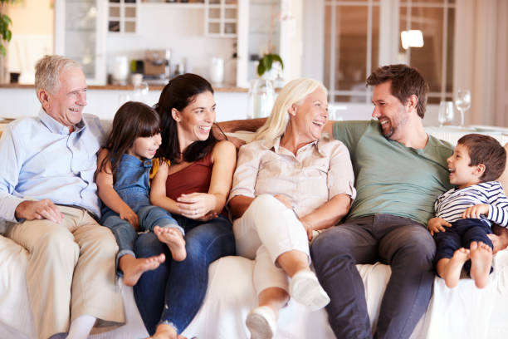
Session 2- Talking about Family
(Like Father, Like Son -Run in the Family- One Big Happy Family -Family Man- A Helicopter Parent)
There is much talk recently of increased social problems due to family breakdown. Is this true?
Student :
Correction:
Do you ever get tired of family duties?
Student :
Correction:
Do you consider close friends as family? Explain why?
Student :
Correction:
Describe this picture.
https://befluent.me/

Slide 42
Session 3 – Revision 1
Thank you!☺
https://befluent.me/

